Slide 1
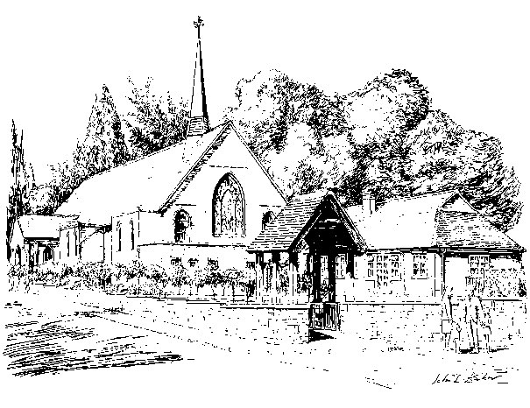
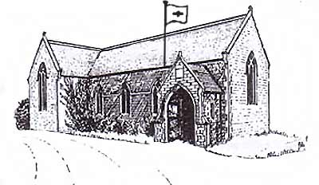
Parishes of Holy Family & Holy Angels Fr. Robin & Dcn. John

Slide 2
The Word who is Life Vision for Mission
“All authority in heaven and on earth has been given to me. Go, therefore, make disciples of all the nations; baptise them in the name of the Father and of the Son and of the Holy Spirit, and teach them to observe all the commands I gave you. And know that I am with you always; yes, to the end of time.”
Mt. 28:16-20
Notes:
Useful to remind ourselves of what this was all about

Slide 3
Bishop Richard set the scene. How did we respond?
Father Robin and Deacon John preached about it on several occasions during Sunday Mass to engage and prime the Parishioners
Notes:
Before handing out questionnaire Fr Robin and Dcn John primed the parishioners what was coming

Slide 4
Bishop Richard set the scene. How did we respond?
We gave out a questionnaire to every Parishioner:
anonymous
qualitative data
quantitative data

Slide 5
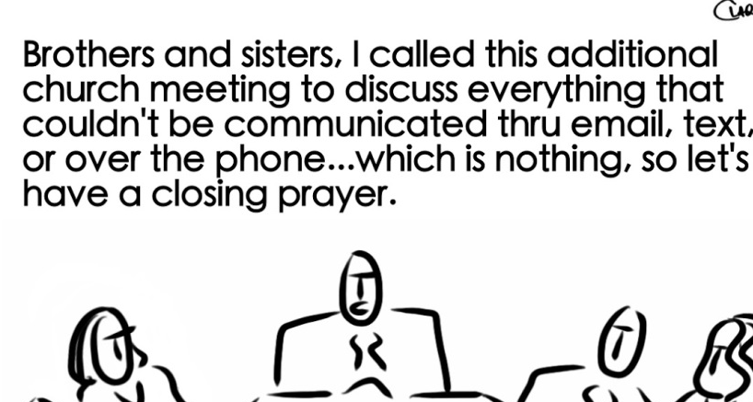
Bishop Richard set the scene. How did we respond?
We held Parish meetings to encourage more discussion around the responses on the questionnaires
Notes:
The questionnaires were returned immediately after Christmas and Parish meetings were held mid January

Slide 6
And what did our Parishioners say in response to our homilies, questionnaires and parish meetings?
Notes:
The parish meetings proved tremendously useful - adding far more value to the survey responses alone. Discussion provided some new thoughts and also gave us an idea of the strength of feelings in some areas

Slide 7
Bishop Richard, you asked:

Slide 8
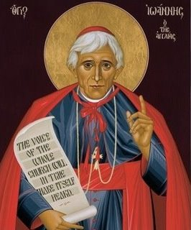
Holy Family & Holy Angels Parishioners said:
In order to achieve mission effectiveness we need:
Faith, hope & charity; Love & prayer
Clear information & education to help us to be formed
A strong sense of community & perseverance in maintaining that community
Openness to the Holy Spirit & spiritual support
Engage younger people & reach out more
A more formal & structured laity
More adult catechesis
Laity to be more engaged / take on additional roles
To combat negative perceptions of the RC Church
Diocesan re structure
Notes:
It was unanimously felt that the laity needed to step up and take on more roles / responsibility and there was much discussion around this issue. In general people felt that they did need more catechesis to be able to take on additional roles though

Slide 9
Bishop Richard, you asked:
Notes:
We then considered, going f/w who could take on what roles?

Slide 10
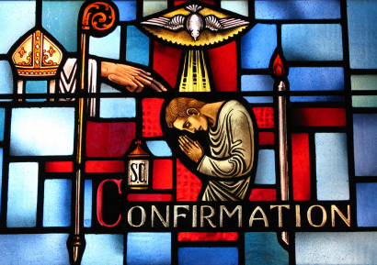
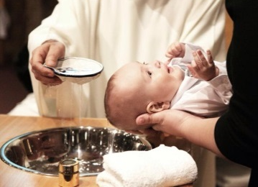
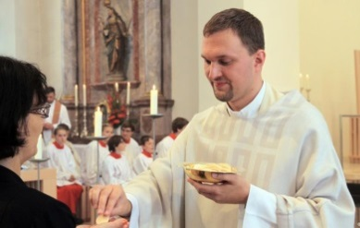
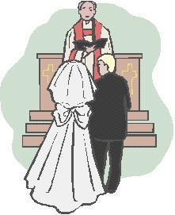
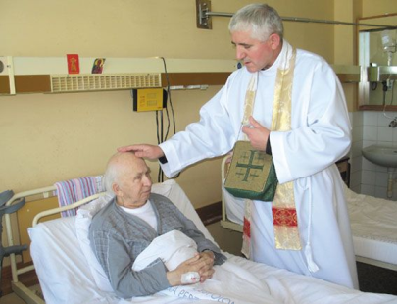
Holy Family & Holy Angels Parishioners said:
A lay administrator:
Each Parish could have a ‘business leader / administrator’ who effectively ran the Parish and was the main PoC leaving the Priest to do that which only a Priests can do. A more wide ranging & engaging role than current parish secretaries.
Notes:
There was a strong feeling that maybe the Parish could be managed by Parish administrator. This role would effectively deal with all non sacramental / business affairs leaving the Priest to do only that which Priests can.

Slide 11
Bishop Richard, you asked:

Slide 12
Holy Family & Holy Angels Parishioners said:
Factors that have facilitated the present situation include
Increasingly secular society with people afraid to speak out
Young men ignoring the call (too many technological distractions)
Priesthood limited & exclusive (celibacy)
Societal decline in Christianity / 24hr society & Sunday trading
Smaller families - less children
Church hierarchy fail to counter damaging arguments – improve PR
Vocations not held in high esteem & RC schools failing to promote Priesthood
Lack of financial support for the Church / obligations not felt
Materialistic society and weak leadership
Lack of parental commitment with young children (sports fixtures)
Catholic schools failing to overtly present Priesthood as viable vocation
Social pressure & media / Church not moved with times
Negative & damaging image of RC clergy perpetuated by media
Fewer & less visibility of nuns
Notes:
Parishioners were quite vocal in how they feel we have arrived at the situation we have.

Slide 13
Bishop Richard, you asked:

Slide 14
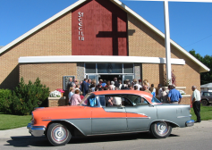
Holy Family & Holy Angels Parishioners said:
Well naturally Bishop Richard you would want to place a Priest in our Parish; But how would the rest of the Diocese manage?
Fewer / merged Churches with Priests & Masses on rotation
More Deacons & Priests retire later
Use of technology: Confessions by Skype / Live streaming of Mass
Sunday Mass on other days
Relax rules on use of Liturgy of The Word & increased use of Mass centres
Overt education regarding ‘the call’ (involve RC schools)
Recruit Priests from overseas
Laity will have to travel further
Increase & improve parental involvement in catechism
We need to make sure that those unable to travel still receive pastoral care
Notes:
There were some novel idea here including Sunday Mass on alternative days of the week!

Slide 15
And so to summarise in the words of our parishioners…
3 things for mission effectiveness?
A prayerful, strong & well formed community open to the Holy Spirit
More formal & structured laity roles (lay administrator)
Engagement of society and ability to counter negative PR

Slide 16
And so to summarise in the words of our parishioners…
Roles for the lay faithful and roles for the Priest?
The lay faithful must be more involved and free up the priests to do what only Priests can

Slide 17
And so to summarise in the words of our parishioners…
Why are we in this situation?
Materialistic secular society with fear of repercussions from evangelisation.
Lack of overt PR about the vocation of Priesthood
Less of everything (children, parental commitment, desire to fulfil obligations)

Slide 18
And my (Fr Robin) thoughts
Parishioners struggled with some of the language of mission and formation and especially in the questionnaires focused more on themselves as individuals than the wider church.
Parish meetings did enhance written feedback via questionnaires - even though largely the same people. Notably of the younger people who did respond they were less represented in the meetings than the questionnaires.
We had to spend some time in the parish meetings pointing out that certain solutions were either outside the Bishop’s authority, or theologically &/or canonically problematic.
Parishioners struggled to see themselves as disciples.
Understandably a strong sense of wanting to stretch things so that things can go on substantially as they are.
A gap between the people saying that laity must take on more and have more formation and people stepping forward.
A need to change from a culture where people only volunteer after Fr asks them…
Real disparity between people’s willingness to change churches because it suits them vs the idea of travelling because we might need to restructure.
Notes:
Fr Robin to expand here

